Slide 1
Large-Scale Stream Processing inside Alibaba
署名：封仲淹(Longda)
职称：资深专家

Slide 2

自我介绍
JStorm/Storm evangelist in China
Our duties:
Application Development
JStorm Platform Evolving
JStorm/Storm Support
Cluster Management
Community Commitment

Slide 3
目录
User Scenario
Architecture
Enhancements
Performance
Stability
Features

Slide 4
JStorm Milestone
Release 25 Jstorm version from 2013/4/30 0.7.1/0.9.0/0.9.1/0.9.2/0.9.3/0.9.3.1/0.9.4/0.9.4.1/0.9.5/0.9.5.1/0.9.6/0.9.6.1/0.9.6.2/0.9.6.3/0.9.7/0.9.7.1/0.9.7.2/0.9.8/0.9.8.1/0.9.8.2/2.0.4/2.1.0/2.1.1/2.2.0/2.2.1
2016/5/31
2.2.0
Improve performance
Exactly Once
Sliding Window
Shade Dependency
Backpressure 3.0
2015/11/12
2.1.0
Donate to apache
Support Storm 0.10 binary
Metrics Redesign
Koala 3.0
2013/4/30
0.7.1
Java core
Scheduler 1.0
2013/12/30
0.9.0
Nimbus HA 1.0
Backpressure 1.0
Scheduler 2.0
2014/10/11
0.9.6.3
Koala 1.0
Scheduler 3.0
User Defined Log
User Defined Metrics 1.0
2015/10/27
0.9.8.1
Koala 2.0
Scheduler 4.0
Backpressure 2.0
Topology Master

Slide 5
当前
Everywhere
4000+ machines
Standalone
JStorm-on-yarn
JStorm-on-docker
1500+ applications, 2000+ topologies
2+ PB every day

Slide 6
应用场景
Fraud Detection: Nut/Velocity
Auditing: Alimama Ads auditing, Alimama P4P auditing, AMG repository auditing, …
Statistics: Eagleeye, AE pv－uv statistics, BI statistics…
Monitoring: Tlog, Rds-monitor, Oceanbase-monitor, Cainiao Raidar, QuaMonitor, YunOSMonitor, …
Data Transport: RDS-log-sync, Unify-Log
Realtime Recommendation: Alipay 1315, Alipay Hyperloop, Tpp
Scheduling Apps: AE mail realtime analyzer, 1688 Wangxiaobao

Slide 7

JStorm 生态

Slide 8
架构
TLog | Kepler | NUT | ARM | RDS | Trip | YunOS | Cainiao | … | Porter (Koala)
SQL engine
Plugin（Kafka/Meta/TT/Mysql/HDFS/Hbase/…） |  |  |  |  | CEP Plugin |  | Trident
Exactly Once |  |  | Extension API |  | Raw Storm API
JStorm Core
Local |  |  | Cluster Standalone, YARN, Fuxi |  |  | Cloud (Docker, ECS, ...)

Slide 9
性能
HW: 32 CPU core/128G Storm version: 1.0.2
Test: Storm FastWordCount JStorm version: 2.2.0
Worker: 6G RAM

Slide 10
性能
Batch Design
Task Pipeline Tuning
Overhead Reduction
UserDefined scheduler
Pipeline
Application
Shuffle
Routing Optimization
Core
Deploy
Metrics Tuning
Improve efficiency
Resolve bottleneck
Serialization Tuning
Improve parallel
Separate spout send/recv

Slide 11
稳定性
Backpressure
UserDefined degrade
Message lifecycle
Userdefined metrics
Userdefined alarm
Degradation
Monitoring
Single failure: nimbusHA
Node self check: checkhealth
Huge deploy: topology-master
High Availability
Across cluster: jstorm-on-docker/standalone
In one cluster: jstorm-on-yarn/cgroup
Isolation
Clusters in different city: hot backup/cold backup
Clusters in one City
Multi-Cluster Deployment

Slide 12
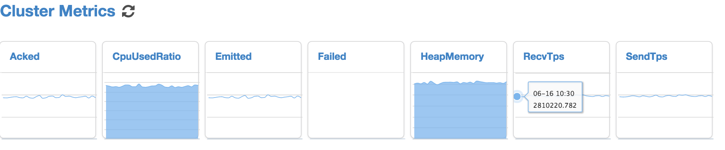
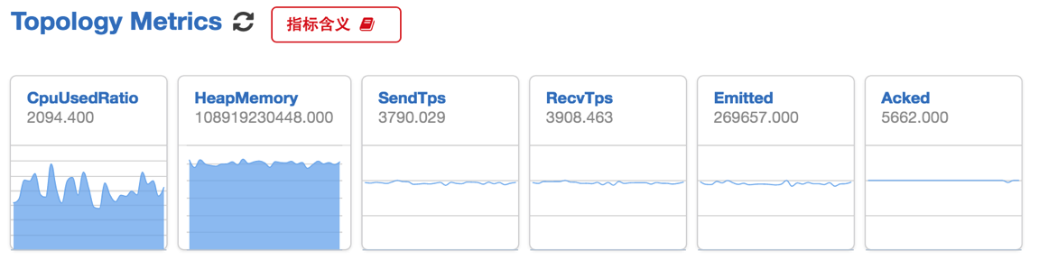
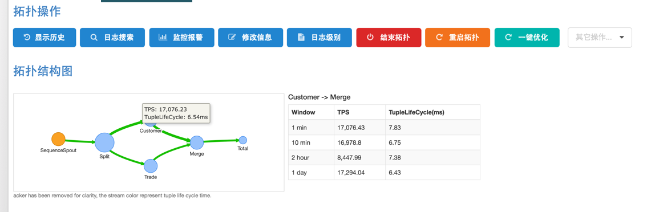
监控系统

Slide 13
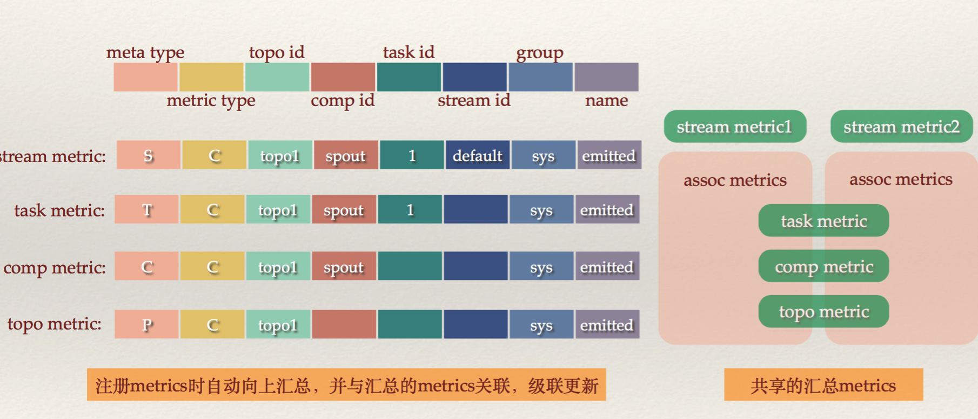
自定义监控
Improving performance: Multiple Layer Metrics Design
Automatically aggregate task level’s metric to component level, then aggregate into topology level
Share common metrics

Slide 14
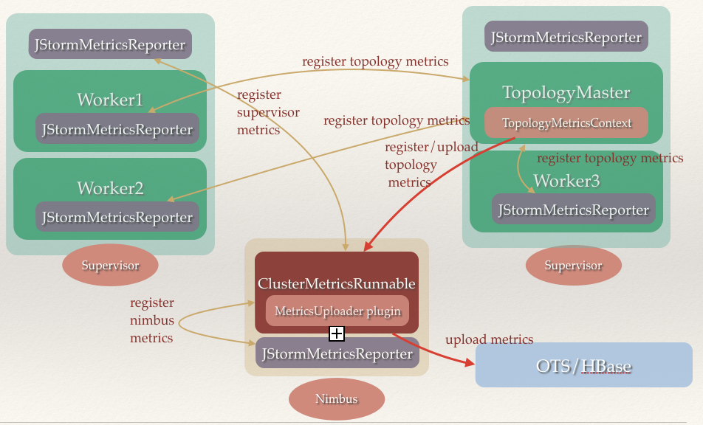
自定义监控

Slide 15
大规模部署
Topology Master
－slave
Nimbus
Topology Master
Metrics
ZK Cluster
Task heartbeat
Control event
Topology Master
Topology Master
Topology Master
Task
Task
Task
Task
Task
Task
Task
Task
Task
Topology
Topology
Topology

Slide 16
反压
JStorm Backpressure 3.0
Exceed Threshold
Task cache
Sending task
Receive task
Receive task
Netty cache
Task cache
Netty client
Netty server
In one worker

Slide 17
其他强化功能
User Side Functionalities
User-Defined Scheduler
User-Defined Resource Usage
Advanced Logging Mechanism
More Fine-Grained Metrics
Graceful Shutdown
Dynamic Rescale/Reload/Restart
Receive Command
Quick Application Upgrade
…

Slide 18
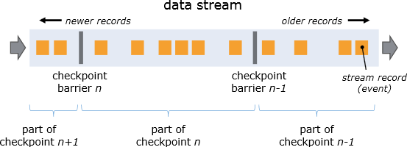
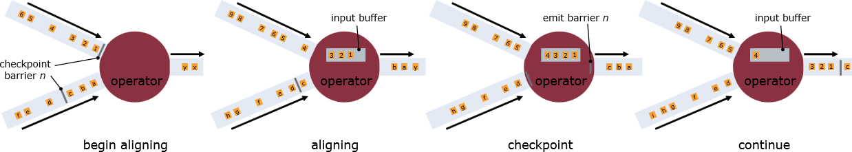
Exactly Once
Chandy-Lamport Algorithm
Barrier
Stream Aligning

Slide 19
Exactly Once
Topology Master
Execute
Checkpoint barrier
Cache db
Jstorm checkpoint
Checkpoint and clear old checkpoint
Spout
Ending bolt
Commit offset
Controller
JStorm checkpoint (optional)
Nexttuple
Hdfs/hbase
Execute
Commit
Normal batch
State bolt
Stateless bolt
Checkpoint barrier
Execute
Execute
Checkpoint barrier
Commit
Checkpoint barrier
Cache db

Slide 20
Exactly Once
Topology Master
Execute
Rollback barrier
Cache db
start
Read last success checkpoint and clean useless checkpoint
rollback
rollback
Spout
Ending bolt
Controller
Nexttuple
Hdfs/hbase
Execute
Read checkpoint (optional)
Rollback
Stateless bolt
State bolt
Rollback barrier
Execute
Rollback barrier
Rollback barrier
Execute
Rollback
Cache db

Slide 21
Future
Apache Beam
A more powerful high level programming framework
Easier to learn, to debug
Provide higher throughput

Slide 22














开源现状
50+ Companies

Slide 23
总结
Why Start JStorm?
Move faster
What’s the difference between JStorm and Storm?
JStorm means Stream Process Ecosystem
JStorm is Enterprise Java Storm
More faster
More stable
More feature

Slide 24
zhongyan.feng@alibaba-inc.com www.jstorm.io

